Slide 1
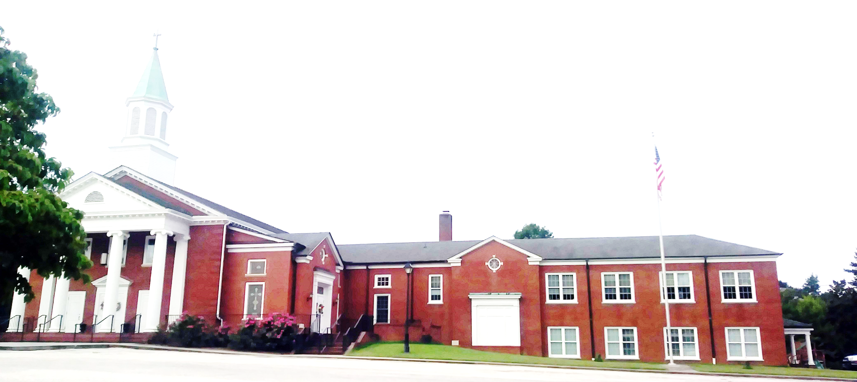
WELCOME!
Enter to Worship. Depart to Serve.
De De Depart t Serve.

Slide 2
Prepare Your Hearts for Worship

Slide 3
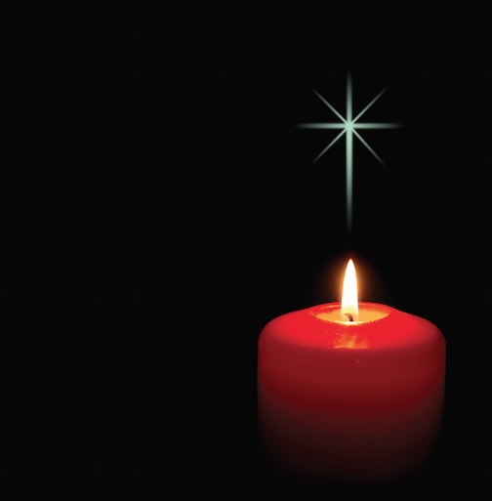
PRELUDE
“Manger Carols” Lani Smith
Piano/Organ Duet: Pam Wilson and Pam Johnson
Lighting of the Christ Candles-Joanne Corley

Slide 4
WELCOME & ANNOUNCEMENTS Lois Miller

Slide 5
OUR CANDLELIGHT CHRISTMAS EVE SERVICE will be at 7 PM. We will receive Holy Communion and celebrate the birth of our Savior, Jesus Christ. There will be story time with Pastor John for the children. The little ones are welcome to wear their pajamas to the service.

Slide 6
THE OFFICE AND WEEKDAY SCHOOL will be closed the week of December 25th through December 29th. If you have an emergency, please call Barbara, at home, and she will contact someone to return your call.

Slide 7
THEON JANUARY 7, 2024, PASTOR JOHN WILL BEGIN A FOUR-PART SERMON SERIES – “Stronger Faith”. Folks today are dealing with more and more stress (maybe that’s you).This series will reveal ways for you to trust God more as we look at

Slide 8
the example of four men in the Old Testament: Noah, Abraham, Jacob and Joseph. This would be a great time to invite a friend who is looking tohave a stronger faith in God.

Slide 9
A HEARTFELT THANK YOU to the Laurel Hill family for your very thoughtful Christmas gift to every staff member. Your love and generosity is very much appreciated by each and every

Slide 10
one of us. We all feel blessed to be able to work for the Lord and for this church family. Be blessed at Christmas and in the New Year.

Slide 11
WE WILL NOT HAVE CHILDREN’S SUNDAY SCHOOL THIS MORNING since we are enjoying our Cantata. Please let your children stay in worship to hear the beautiful music. Thank you.

Slide 12
LIGHTING OF THE ADVENT WREATH
Third Sunday/Joy: Barbara Austin
After the reading and the candle is lit, please join us to read…

Slide 13
“Dear God, you loved us so much that you sent your only Son, Jesus Christ, to live and die for us. We pray that you remind us this week of your love for us and that we may share your love with others. Let us live in the reality of your free and eternal love. Amen.”

Slide 14
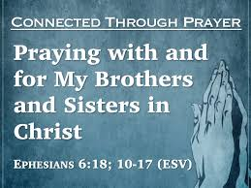
Greeting our Brothers and Sisters

Slide 15
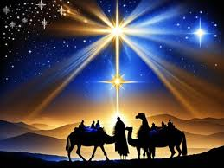
OPENING HYMN
“It Came Upon A
Midnight Clear”
(UMH 218)

Slide 16
It came upon the midnight
clear, that glorious song of old, from angels bending near the earth, to touch their harps of gold:
“Peace on the earth, good will to men, *from heaven’s all gracious King.” The world in solemn stillness lay, to hear the angels sing.

Slide 17
2. Still through the cloven skies they come with peaceful wings unfurled, and still their heavenly music floats o’er all the weary world; above its sad and lowly plains, they bend on hovering wing, and ever o’er its Babel sounds the blessed angels sing.

Slide 18
3. And ye, beneath life’s crushing load, whose forms are bending low, who toil along the climbing way with painful steps and slow, look now! For glad and golden hours come swiftly on the wing. O rest beside the weary road, and hear the angels sing!

Slide 19
4. For lo! The days are hastening on, by prophet seen of old, when with the ever circling years shall come the time foretold when peace shall over all the earth its ancient splendors fling, and the whole world send back the song which now the angels sing.

Slide 20
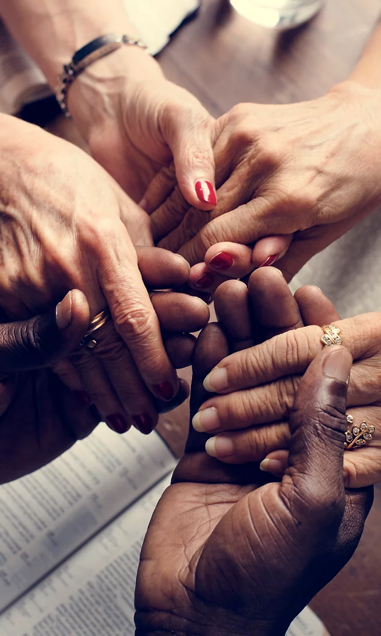
JOYS & CONCERNS Lois Miller

Slide 21
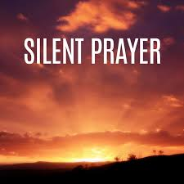
S
Rev. John Bright

Slide 22
ANTHEM
“Do You Hear What I
Hear?” Noel Regney
And Gloria Shayne

Slide 23
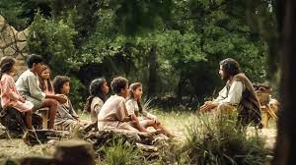
CHILDREN’S MESSAGE
by Pastor John Bright

Slide 24
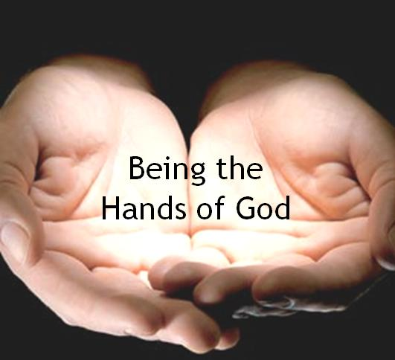
TITHES & OFFERINGS
“My Tribute”(UMH 99)
Offertory Prayer
Rev. John Bright

Slide 25
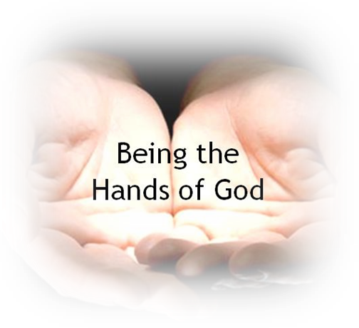
TITHES & OFFERINGS
To God be the glory, (X3) For the things He has done. With His blood He has saved me, With His power He has raised me, To God be the glory, For the things He has done.
“My Tribute”(UMH 99)

Slide 27
Apostles’ Creed (UMH 881)
I believe in God the Father Almighty, maker of heaven and earth; And in Jesus Christ his only son, our Lord; who was conceived by the Holy Spirit, born of the Virgin Mary, suffered under Pontius Pilate was crucified, dead, and

Slide 28
buried, the third day he rose from the dead; he ascended into heaven, and sitteth at the right hand of God the Father Almighty; from thence he shall come to judge the quick and the dead.

Slide 29
I believe in the Holy Spirit, the holy catholic church, the communion of saints, the forgiveness of sins, the resurrection of the body, and the life everlasting. Amen

Slide 30
Scripture Lesson-Luke 1:26-38
The Birth of Jesus Fortold
26 In the sixth month of Elizabeth’s pregnancy, God sent the angel Gabriel to Nazareth, a town in Galilee, 27 to a virgin pledged to be married to a many named Joseph, a descendant of David. The virgin’s name was Mary. 28 The angel went to her an said “greetings, you who are highly favored! The Lord is with you.”

Slide 31
27 to a virgin pledged to be married to a man named Joseph, a descendant of David. The virgin’s name was Mary. 28 The angel went to her an said “greetings, you who are highly favored! The Lord is with you.” 29 Mary was greatly troubled at his words and wondered what
kind of greeting this might be.

Slide 32
30 But the angel said to her, “Do not be afraid, Mary; you have found favor with God. 31 You will conceive and give birth to a son, and you are to call him Jesus. 32 He will be great and will be called the Son of the Most High. The Lord God will give him the throne of his father
David.

Slide 33
33 And he will reign over Jacob’s descendants forever; his kingdom will never end.” 34 “How will this be,” Mary asked the angel, “since I am a virgin?”
35 The angel answered, “The Holy Spirit will come on you, and the power of the Most High will overshadow you.
36 So the holy one to be born will be called the Son of God.

Slide 34
So the holy one to be born will be called the Son of God. 36 Even Elizabeth your relative is going to have a child in her old age, and she sho was said to be unable to conceive is in her sixth month. 37 For no word from God will ever fail.”

Slide 35
38 “I am the Lord’s servant,” Mary answered. “May your word to me be fulfilled.” Then the angel left her.

Slide 36
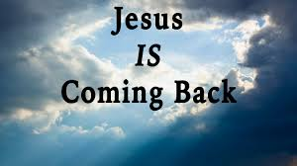
SERMON
,
“The Fine Art of the Double-Take”
Rev. John Bright

Slide 37
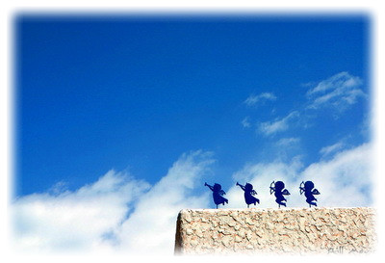
CLOSING HYMN ____________
“O Little Town of
Bethlehem”
(UMH 230)

Slide 38
1. O little town of Bethlehem, how still we see thee lie; above thy deep and dream-less sleep the silent stars go by. Yet in thy dark streets shineth the everlasting light; the hopes and fears of all the years are met in thee tonight.

Slide 39
2. For Christ is born of Mary, and gathered all above, while mortals sleep, the angels keep their watch of wondering love. O morning stars together, proclaim the holy birth, and praises sing to God the King, and peace to all on earth!

Slide 40
3. How silently, how silently, the wondrous gift is given; so God imparts to human hearts the blessings of his heaven. No ear may hear his coming, but in this world of sin, where meek souls will receive him, still the dear Christ enters in.

Slide 41
4. O holy Child of Bethlehem, descend to us, we pray; cast out our sin, and enter in, be born in us today. We hear the Christmas angels the great glad tidings tell; O come to us, abide with us, our Lord Emmanuel!

Slide 42
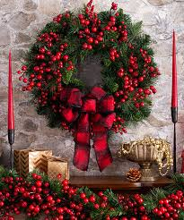
BENEDICTION
Rev. John Bright

Slide 43
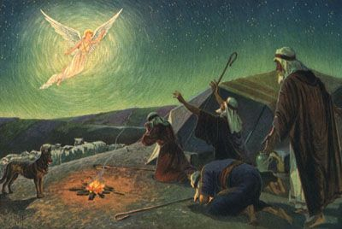
POSTLUDE
“Gloria”
By Hugh S. Livingston
Organist: Pam Wilson

