Slide 1
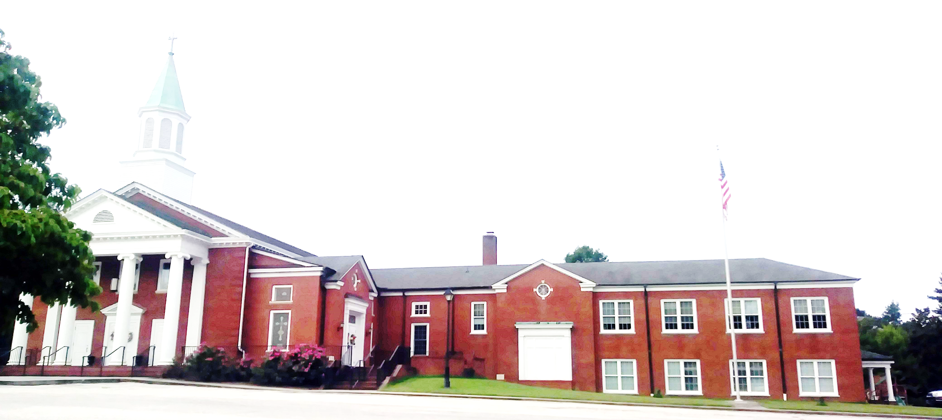
WELCOME!
Enter to Worship. Depart to Serve.
De De Depart t Serve.

Slide 2
Prepare Your Hearts for Worship

Slide 3
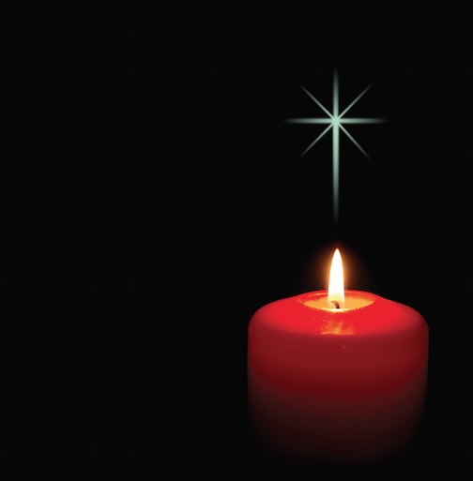
PRELUDE
“Fantasia on “The First Nowell” Henry Balcombe
Organist: Pam Wilson
Lighting of the Christ Candles- Kathie Whitlow

Slide 4
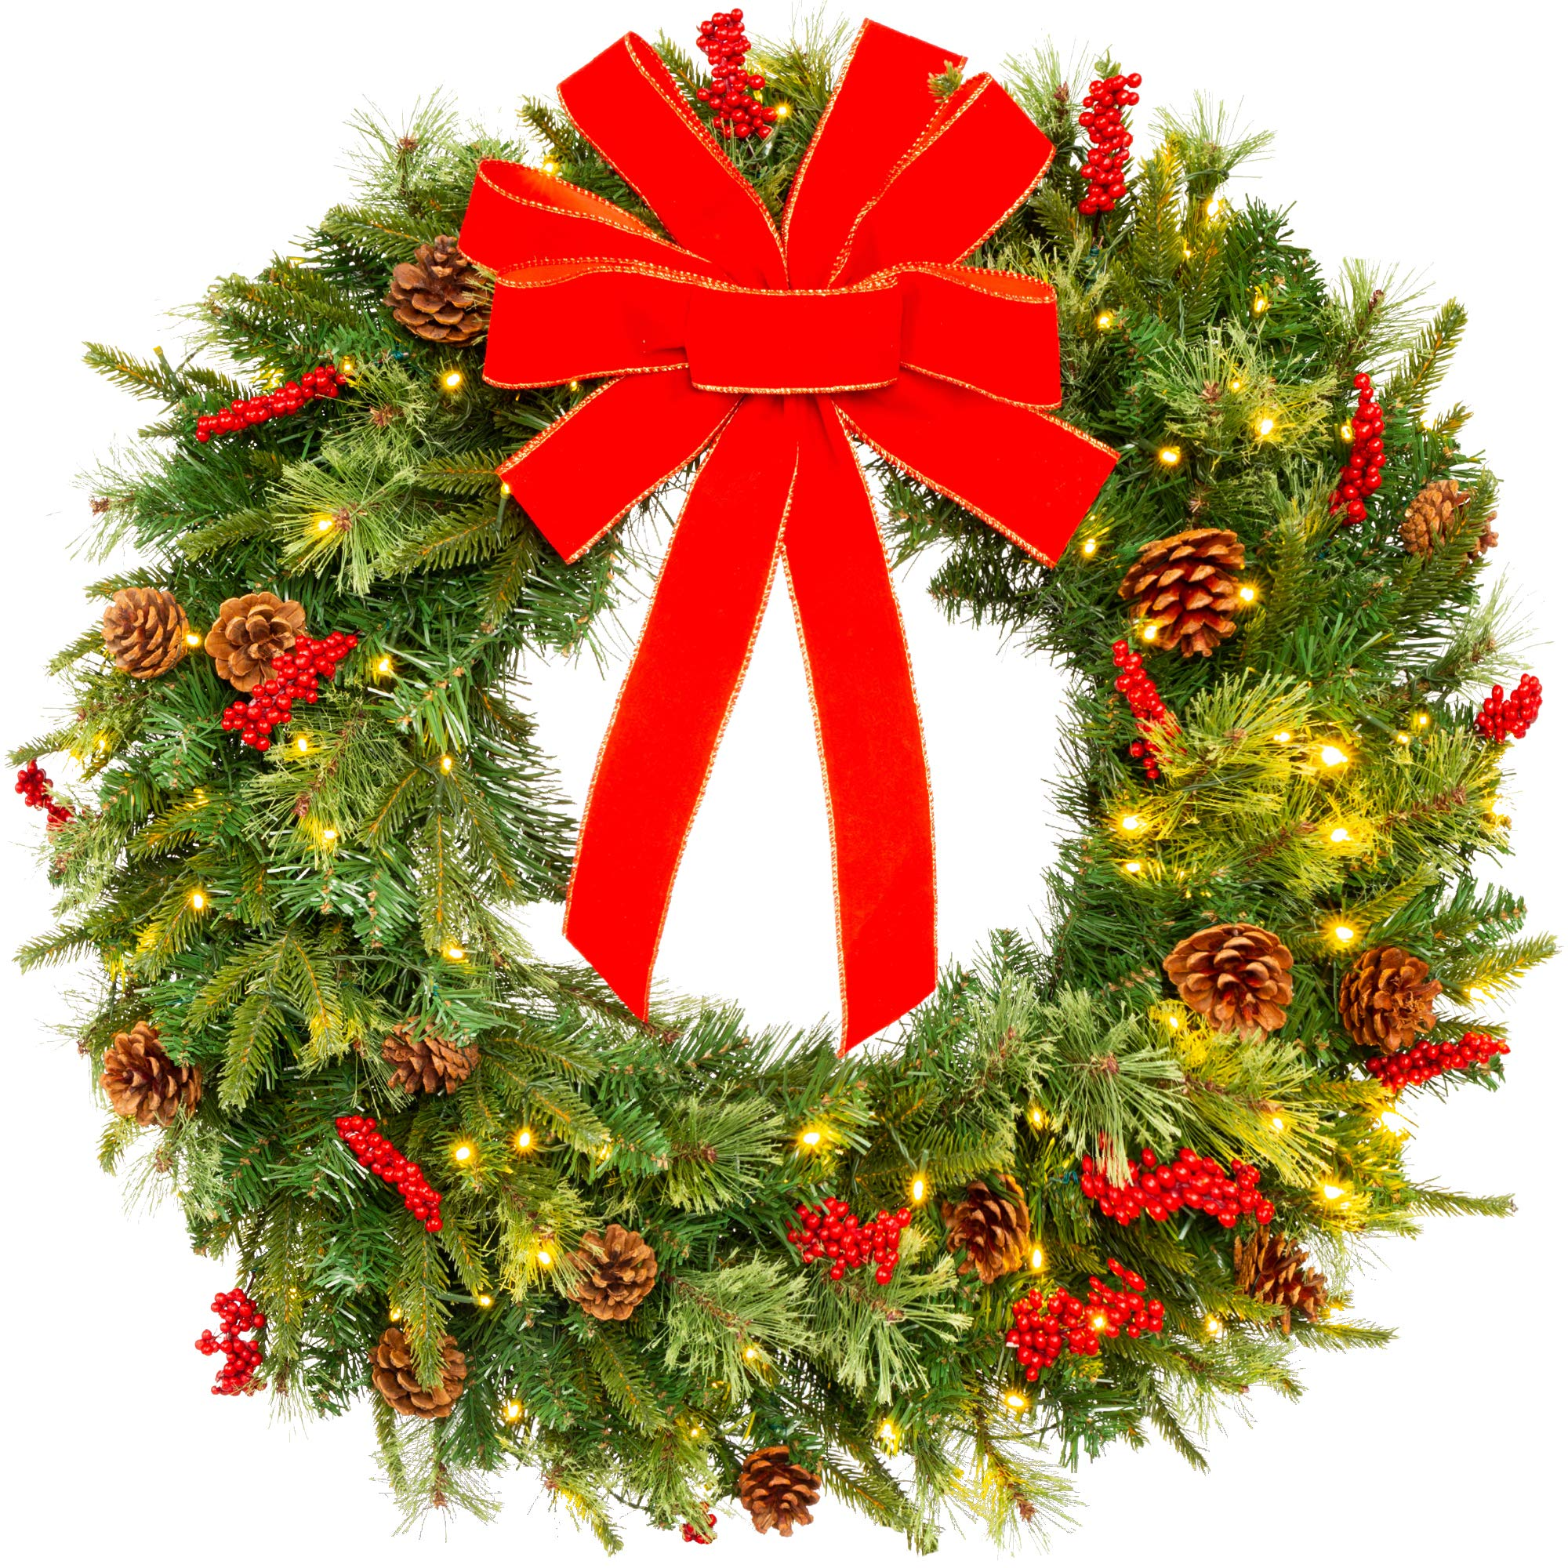
WELCOME & ANNOUNCEMENTS Buddy Whitlow

Slide 5
WE ARE SO PLEASED to receive our new members this morning. Hilda Rose (Franklin) and Karen Pitts. They both come as transfers from other denominations.

Slide 6
THANK YOU to our Chancel Choir and Pam for presenting our wonderful Cantata this morning. This represents many hours of rehearsal and dedication to make this special for our Christmas season. We appreciate all the effort that was made on our behalf.

Slide 7
THE HANDBELL CHOIR and Chancel Choir will not rehearse again until the first week in January. Watch for details.

Slide 8
THIS IS THE LAST SUNDAY TO ORDER A POINSETTIA. There are order forms on the table in the narthex.

Slide 9
WE WANT TO BLESS OUR PASTOR AND STAFF with a Christmas Gift from our congregation. Today is your last opportunity to make a contribution. Thank you.

Slide 10
WE WILL NOT HAVE CHILDREN’S SUNDAY SCHOOL THIS MORNING since we are enjoying our Cantata. Please let your children stay in worship to hear the beautiful music. Thank you.

Slide 11
LIGHTING OF THE ADVENT WREATH
Third Sunday/Joy: Barbara Wendel
After the reading and the candle is lit, please join us to read…

Slide 12
“Dear Jesus, you came to bring us Joy. Help us to not to find our joy in the things of this world, but in you and your Kingdom. This week in our Advent journey, open our eyes to the joy that surrounds us. Amen.”

Slide 13
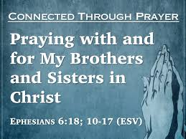
Greeting our Brothers and Sisters

Slide 14
Reception of New Members Hilda Rose(Franklin) and Karen Pitts

Slide 15
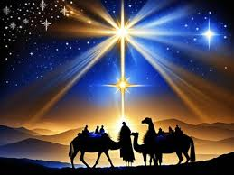
OPENING HYMN
“Hark, The Herald
Angel Sings””
(UMH 240)

Slide 16
1. Hark! The herald angels sing, “Glory to the newborn King; peace on earth, and mercy mild, God and sinners reconciled.” Joyful, all ye nations rise, join the triumph of the skies; with th’angelic host proclaim, “Chris is born in Bethlehem!” Hark! the herald angels sing, “Glory to the newborn King!”

Slide 17
2. Christ, by highest heaven adored; Christ, the everlasting Lord; late in time behold him come, off-spring of a virgin’s womb. Veiled in flesh the God-head see; hail th’incarnate Deity, pleased with us in flesh to dwell, Jesus, our Emmanuel. Hark! The herald angels sing, “Glory to the newborn King.”

Slide 18
3. Hail the heaven born Prince of Peace! Hail the Sun of Righteousness! Light and life to all he brings, risen with healing in his wings. Mild he lays his glory by, born that we no more may die, born to raise us from the earth, born to give us second birth. Hark! The herald angels sing, “Glory to the newborn King.”

Slide 19
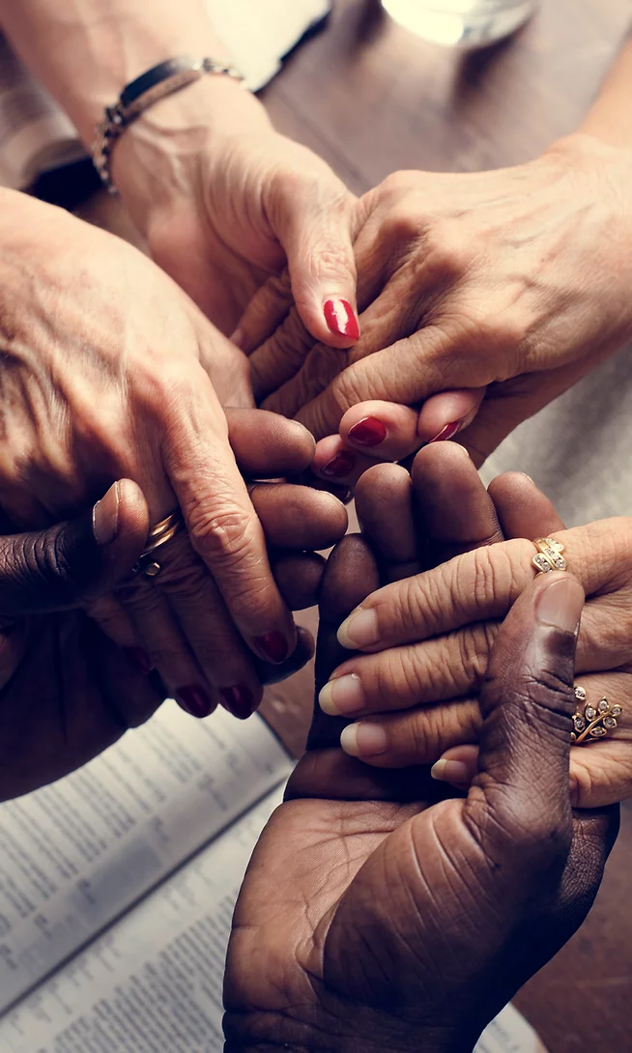
JOYS & CONCERNS Buddy Whitlow

Slide 20
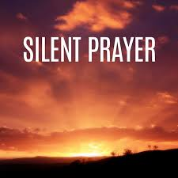
S
Rev. John Bright

Slide 21
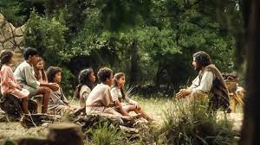
CHILDREN’S MESSAGE
by Pastor John Bright

Slide 22
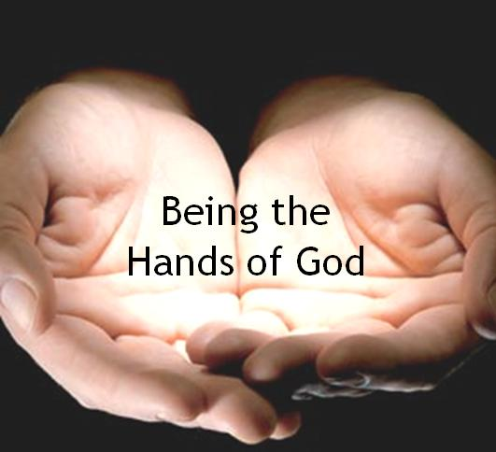
TITHES & OFFERINGS
“My Tribute”(UMH 99)
Offertory Prayer
Rev. John Bright

Slide 23
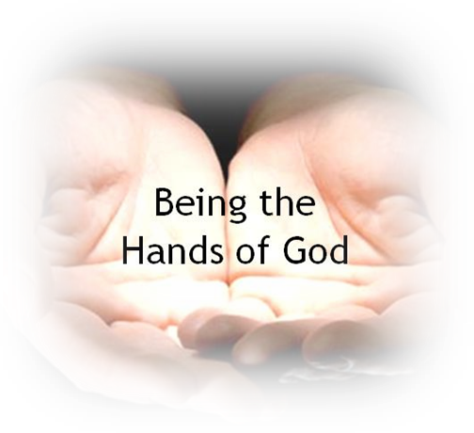
TITHES & OFFERINGS
To God be the glory, (X3) For the things He has done. With His blood He has saved me, With His power He has raised me, To God be the glory, For the things He has done.
“My Tribute”(UMH 99)

Slide 25
Apostles’ Creed (UMH 881)
I believe in God the Father Almighty, maker of heaven and earth; And in Jesus Christ his only son, our Lord; who was conceived by the Holy Spirit, born of the Virgin Mary, suffered under Pontius Pilate was crucified, dead, and

Slide 26
buried, the third day he rose from the dead; he ascended into heaven, and sitteth at the right hand of God the Father Almighty; from thence he shall come to judge the quick and the dead.

Slide 27
I believe in the Holy Spirit, the holy catholic church, the communion of saints, the forgiveness of sins, the resurrection of the body, and the life everlasting. Amen

Slide 28
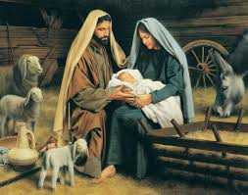
THE CANTATA
,
“The Road to Bethlehem”
By Lloyd Larson/Chancel Choir

Slide 29
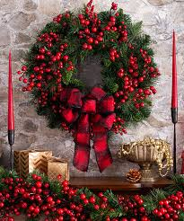
BENEDICTION
Rev. John Bright

Slide 30
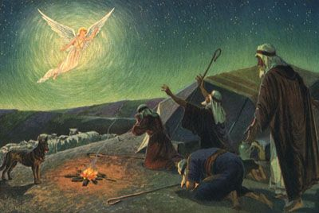
POSTLUDE
“Christmas Joy”
by Franklin Ritter
Organist: Pam Wilson

