Slide 1
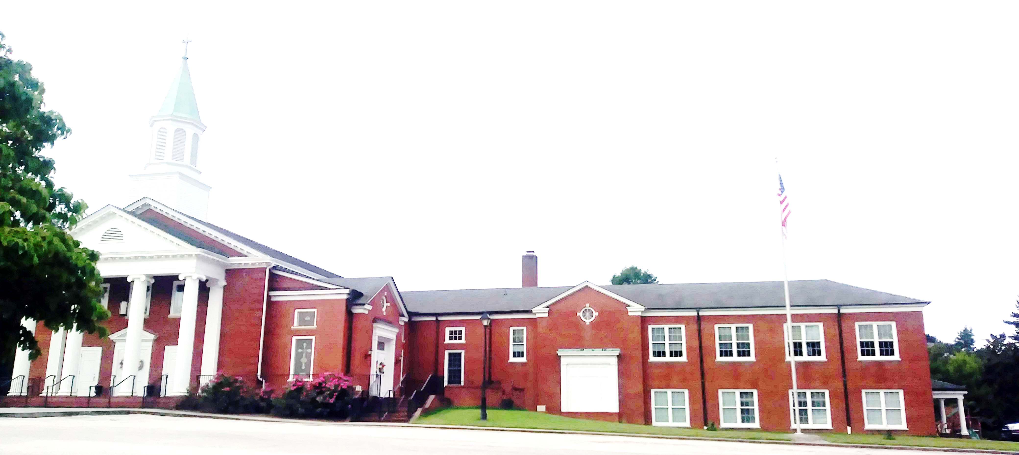
WELCOME!
Enter to Worship.
Depart to Serve.

Slide 2


Prepare Your Hearts for Worship

Slide 3
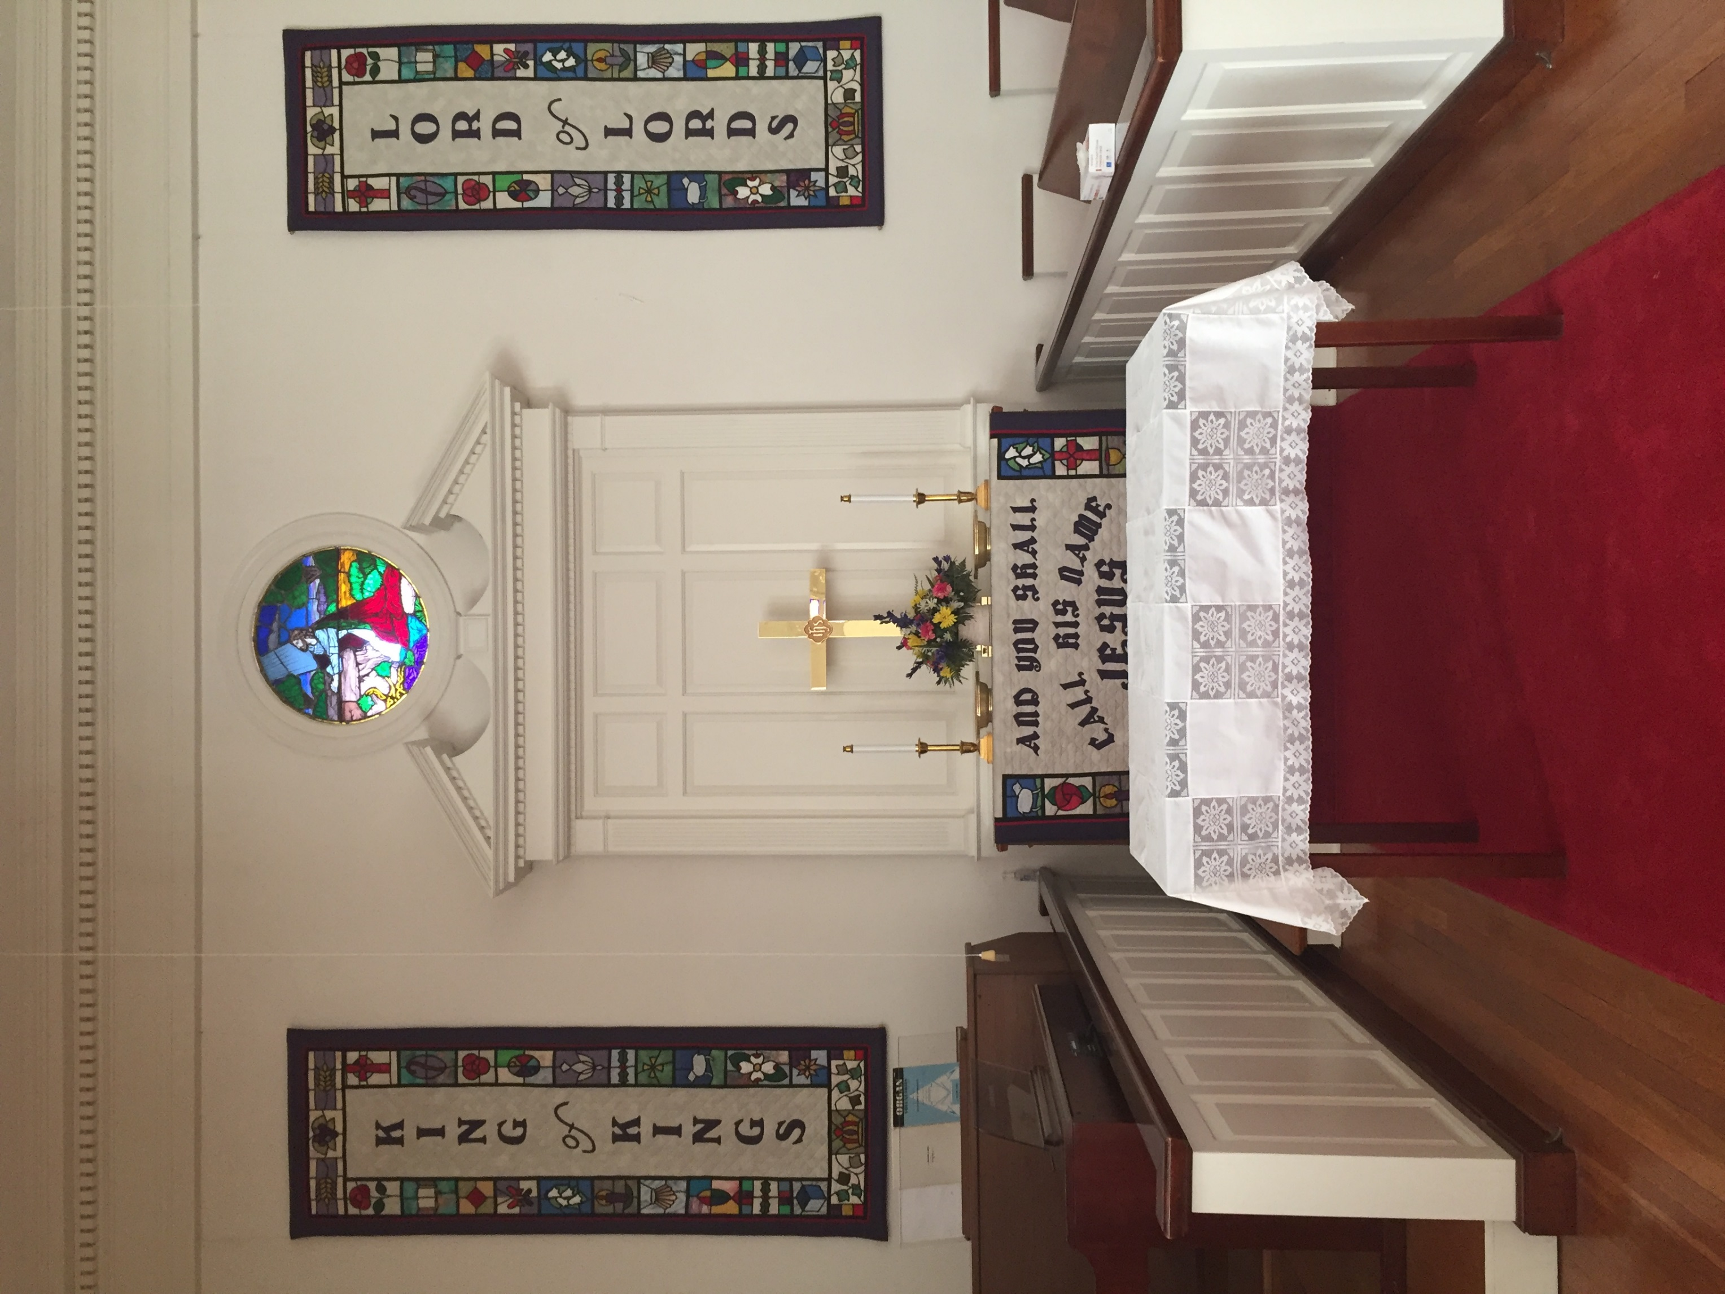
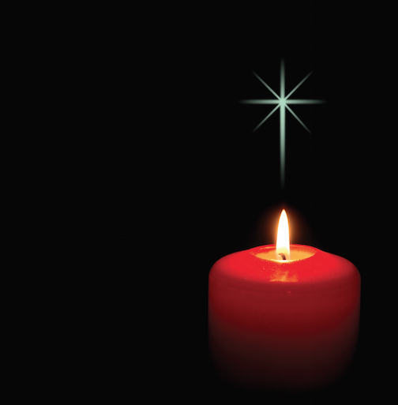
PRELUDE
“Fill My Cup, Lord”
Richard Blanchard
Organist: Pam Wilson
LIGHTING OF CHRIST CANDLES
Lois Miller

Slide 4

WELCOME
&
ANNOUNCEMENTS
Dale Dixon

Slide 5
THE ALTAR FLOWERS are presented to the Glory of almighty God and given in honor of the 10th anniversary of Ann and Henry Ragland on July 4th.

Slide 6
WE WELCOME Ann Via as our speaker this morning and Dale Dixon as our liturgist. Thank you for your generosity in serving our Laurel Hill congregation.

Slide 7
VACATION BIBLE SCHOOL will be July 17-21 from 9 A.M. until Noon. Volunteers are needed. The ages are 3 to 12 years. Please contact Dale Dixon if you can help. This is a wonderful way to serve God and the children. Thank you.

Slide 8
THE CHURCH OFFICE will be closed for the 4th of July holiday.

Slide 9

CALL TO WORSHIP
L: By faith, we trust that we were created in the image of God.
P: By faith, we hope and dream and make plans.

Slide 10
L: By faith, we face our fears and insecurities.
P: By faith, we till the soil of our lives and plant seeds of love.

Slide 11
L. By faith, we follow where God leads.
P. By faith, we trust that God is present in our midst.

Slide 12
ALL. By faith, we gather in this place to worship God together.

Slide 13
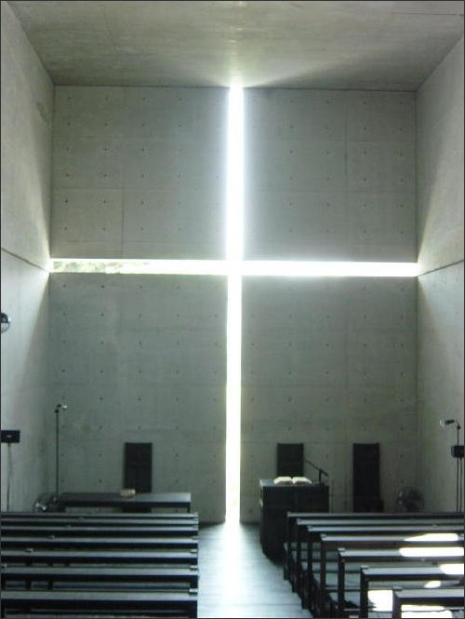
OPENING PRAYER
Dale Dixon

Slide 14
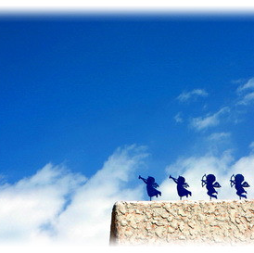
OPENING HYMN
“Joyful, Joyful, We Adore Thee”
(UMH 89)

Slide 15
1. Joyful, joyful, we adore thee, God of glory, Lord of love, hearts unfold like flowers before thee, opening to the sun above. Melt the clouds of sin and sadness; drive the dark of doubt away. Giver of immortal gladness, fill us with the light of day.

Slide 16
2. All thy works with joy surround thee, earth and heaven reflect thy rays, stars and angels sing around thee, center of unbroken praise. Field and forest, vale and moun- tain, flowery meadow, flashing sea, chanting bird and flowing fountain, call us to rejoice in thee.

Slide 17

3. Thou art giving and forgiving, ever blessing, ever blest, well-spring of the joy of living, ocean depth of happy rest! Thou our Father, Christ our brother, all who live in love are thine; teach us how to love each other, lift us to the joy divine.

Slide 18
4. Mortals, join the mighty chorus which the morning stars began; love divine is reigning o’er us, binding all within its span. Ever singing, march we onward, victors in the midst of strife; joyful music leads us sunward, in the triumph song of life.

Slide 19
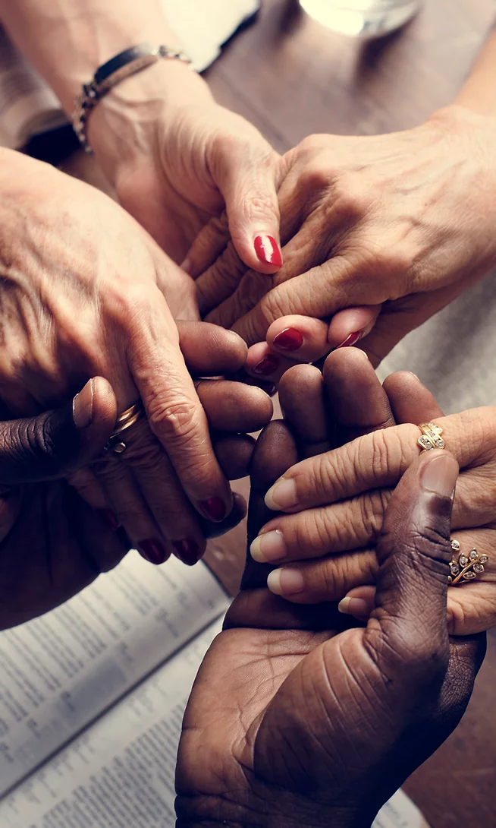
JOYS & CONCERNS
Dale Dixon

Slide 20

Dale Dixon

Slide 21

ANTHEM
“One Step He Leads”
Pepper Choplin
Chancel Choir

Slide 22
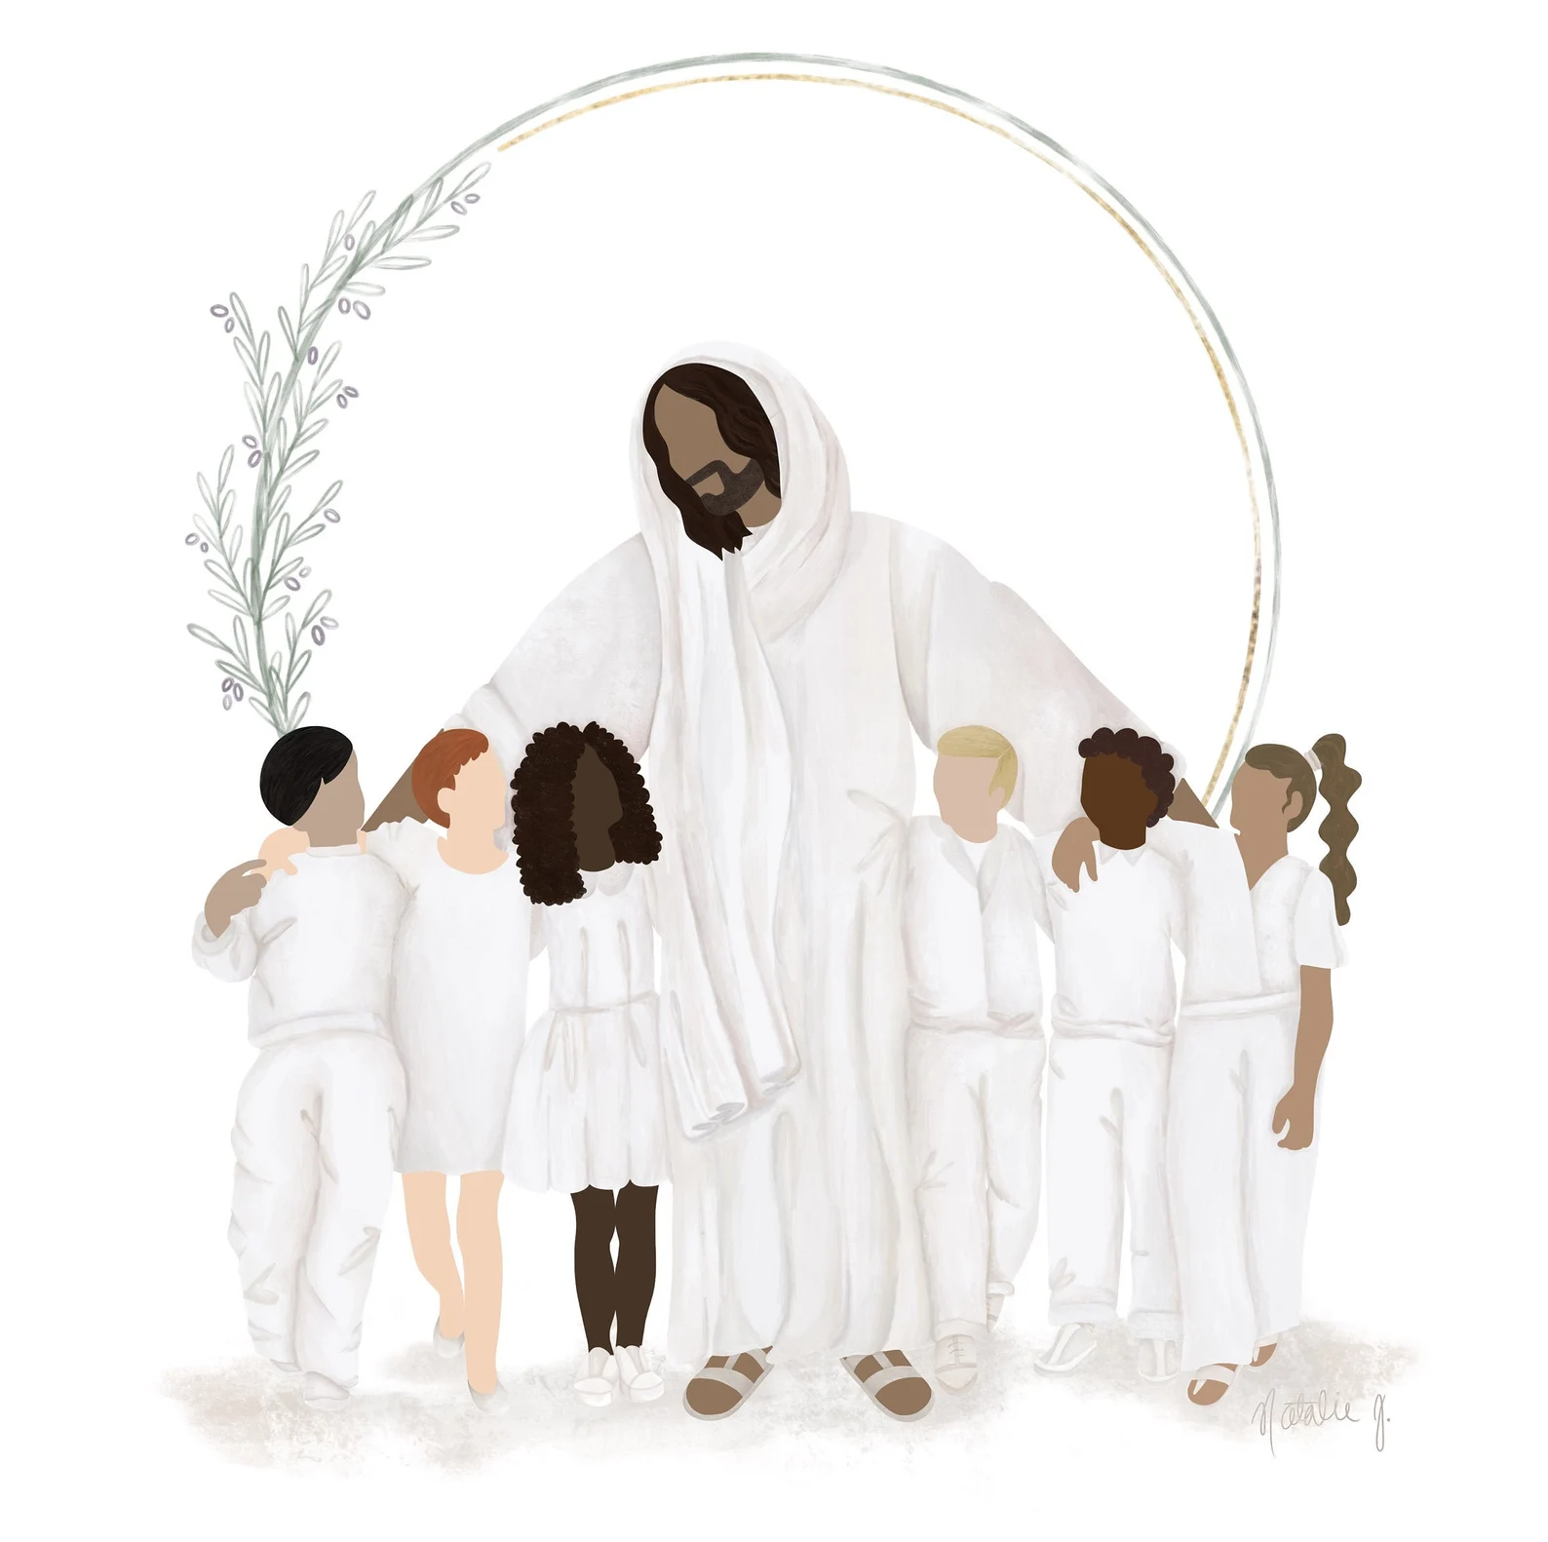
CHILDREN’S MESSAGE
Jenny Nelson

Slide 23
SCRIPTURE LESSON
^{Matthew 14:22-29}
^{Ann Via}

Slide 24
Matthew 14:22-29
Jesus Walks on the Water
Immediately Jesus made the disciples get into the boat and go on ahead of him to the other
side, while he dismissed the
crowd.

Slide 25
After he had dismissed them, he went up on a mountainside by himself to pray. Later that night, he was there alone, and the boat was already a considerable distance from land, buffered by the
waves because the wind was against it.

Slide 26
Shortly before dawn Jesus went out to them, walking on the lake. When the disciples saw him walking on the lake, they were terrified. “It’s a ghost,” they said, and cried out in fear.

Slide 27
But Jesus immediately said to them: “take courage! It is I. Don’t be afraid.”

Slide 28
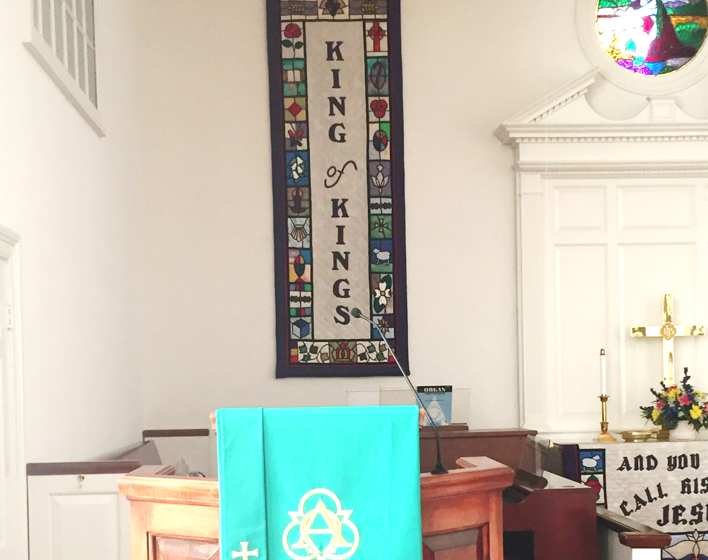
SERMON
“Step Out in Faith”
Ann Via

Slide 29
HYMN OF RESPONSE
“He Leadeth Me”
(UMH 128)

Slide 30
1. He leadeth me: O blessed thought! O words with heavenly comfort fraught! What e’er I do, where e’er I be, still ‘tis God’s hand that leadeth me.

Slide 31
(Refrain)
He leadeth me, he leadeth me, by his own hand he leadeth me, his faithful follower I would be, for by his hand he leadeth me.

Slide 32
2. Sometimes mid scenes of deepest gloom, sometime where Eden’s bowers bloom, by waters still, o’er troubled sea, still ‘tis his hand that leadeth me.

Slide 33
(Refrain)
He leadeth me, he leadeth me, by his own hand he leadeth me; his faithful follower I would be, for by his hand he leadeth me.

Slide 34
3. Lord, I would place my hand in thine, nor ever murmur nor repine; content, whatever lot I see, since ‘tis my God that leadeth me.

Slide 35
(Refrain)
He leadeth me, he leadeth me, by his own hand he leadeth me; his faithful follower I would be, for by his hand he leadeth me.

Slide 36
4. And when my task on earth is done, when by thy grace the victory’s won, e’en death’s cold wave I wil not flee, since God through Jordan leadeth me.

Slide 37
(Refrain)
He leadeth me, he leadeth me, by his own hand he leadeth me; his faithful follower I would be, for by his hand he leadeth me.

Slide 38
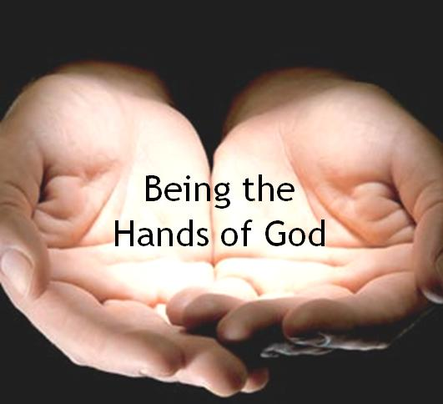
TITHES & OFFERINGS
“My Tribute”(UMH 99)
Offertory Prayer
Ann Via

Slide 39

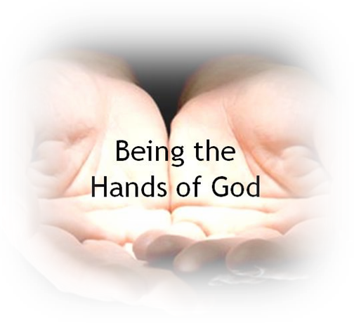
TITHES & OFFERINGS
To God be the glory, (X3)
For the things He has done.
With His blood He has saved me,
With His power He has raised me,
To God be the glory,
For the things He has done.
“My Tribute”(UMH 99)

Slide 40
OFFERTORY PRAYER
_______________
Ann Via

Slide 41
HYMN OF
COMMITMENT
____________
“Stand Up, Stand
Up for Jesus”
(UMH 514)

Slide 42
1. Stand up, stand up for Jesus, ye soldiers of the cross; lift high his royal banner, it must not suffer loss. From victory unto victory his army shall he lead, till every foe is vanquished, and Christ is Lord indeed.

Slide 43
2. Stand up, stand up for Jesus, the trumpet call obey; forth to the mighty conflict, in this his glorious day. Ye that are brave now serve him against unnumbered foes; let courage rise with danger, and strength to strength oppose.

Slide 44
3. Stand up, stand up for Jesus, stand in his strength alone; the arm of flesh will fail you, ye dare not trust your own. Put on the gospel armor, each piece put on with prayer; where duty calls or danger, be never wanting there.

Slide 45
4. Stand up, stand up for Jesus, the strife will not be long; this day the noise of battle, the next the victor’s song. To those who vanquish evil a crown of life shall be; they with the King of Glory shall reign eternally.

Slide 46
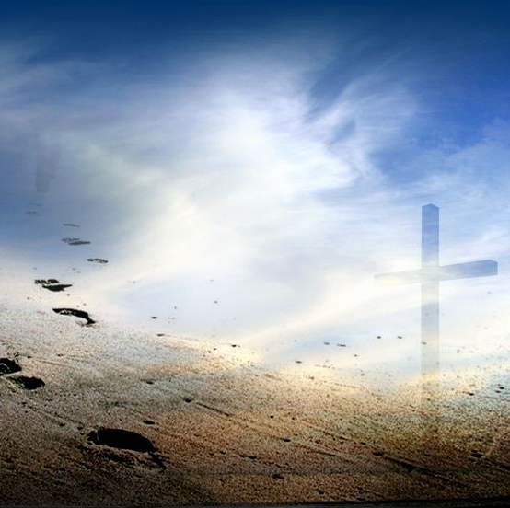
BENEDICTION
Ann Via

Slide 47
POSTLUDE
“Ye Are the Light of the World”
Edward Broughton
Organist: Pam Wilson

