Slide 1
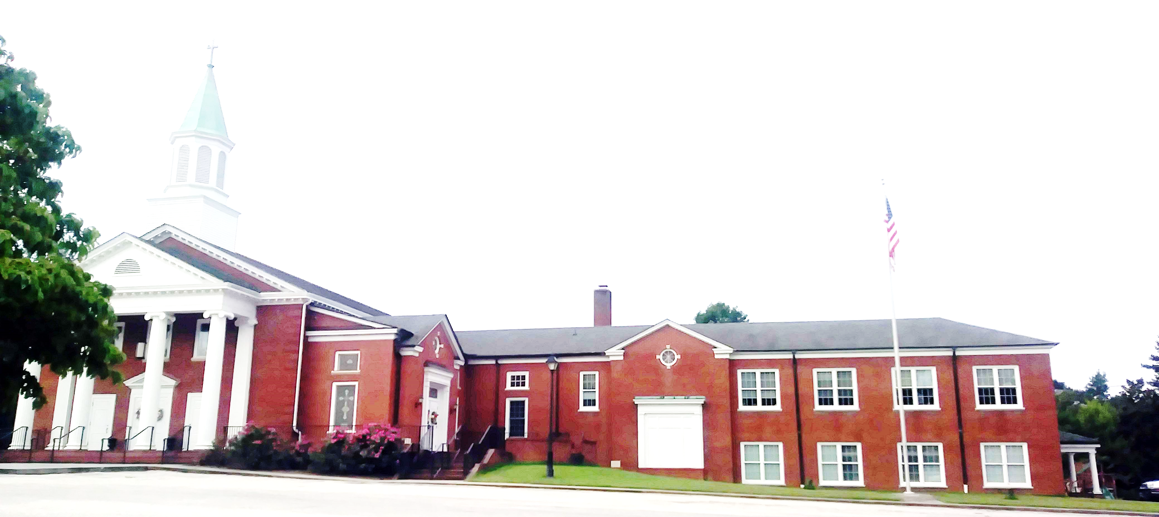
WELCOME!
Enter to Worship.
Depart to Serve.

Slide 2
Prepare Your Hearts for Worship

Slide 3
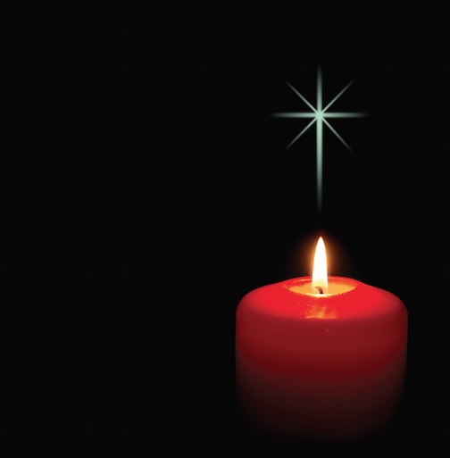
LIGHTING OF CHRIST CANDLES Ann Ragland

Slide 4
PRELUDE
“Meditation on ‘Germany’”
Alvin Whitworth
Organist: Pam Wilson

Slide 5
WELCOME & ANNOUNCEMENTS
Ann Ragland

Slide 6
OUR ALTAR FLOWERS are presented to the Glory of Almighty God, His Only Son, our Lord, Jesus Christ and the Holy Spirit. The flowers are given in memory of Arie Brandon. Arie has been such a faithful member of Laurel Hill for so long and is loved by all of us.

Slide 7
WE WELCOME Bud Funk as our speaker this morning and Ann Ragland as our liturgist. Thank you for your generosity in serving our Laurel Hill congregation.

Slide 8
THANK YOU to the Laurel Hill family for your prayers, cards, calls, and all other expressions of your love and concern at the passing of my sister. This has blessed me at a difficult time. Kathleen McKinsey

Slide 9
THE LADIES OF LAUREL HILL will travel to Surry, Va. to dine at the Surry Seafood Restaurant on Tuesday, June 13th. Meet at church at 10:30. Some may wish to carpool. Let Joanne Corley know if you will attend so we won’t leave anyone behind.

Slide 10
VACATION BIBLE SCHOOL will be July 17-21 from 9 A.M. until Noon. Volunteers are needed. The ages are 3 to 12 years. Our theme this year is HERO HOTLINE: Called Together to Serve God! Please contact Dale Dixon if you can help. This is a wonderful way to serve God and the children. Thank you.

Slide 11
CALL TO WORSHIP
L: God of Love, You care for us as a Shepherd,
P:Leading us to fresh pasture and living water;
L:You care for us as a Holy Parent,

Slide 12
CALL TO WORSHIP
P: Drawing us closer, to you and each other, within your tender embrace.
L: You care for us as a Savior,
P: Forgiving all who reach out to You in faith.

Slide 13
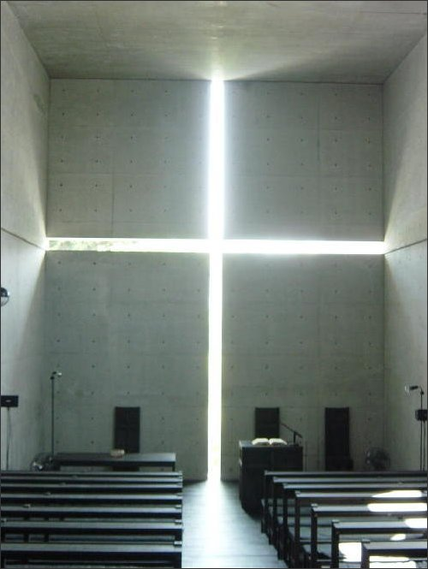
OPENING PRAYER
Ann Ragland

Slide 14
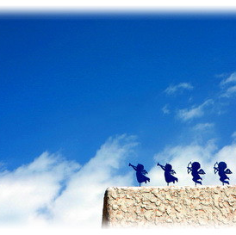
OPENING HYMN
“His Name Is Wonderful” (UMH 174)

Slide 15
1. His name is wonderful, his name is wonderful,his name is wonderful, Jesus, my Lord. He is the mighty King, Master of everything; his name is wonderful, Jesus my Lord.

Slide 16
He’s the great Shepherd, the Rock of all ages, almighty God is he; bow down before him, love and adore him, his name is wonderful, Jesus my Lord.

Slide 17
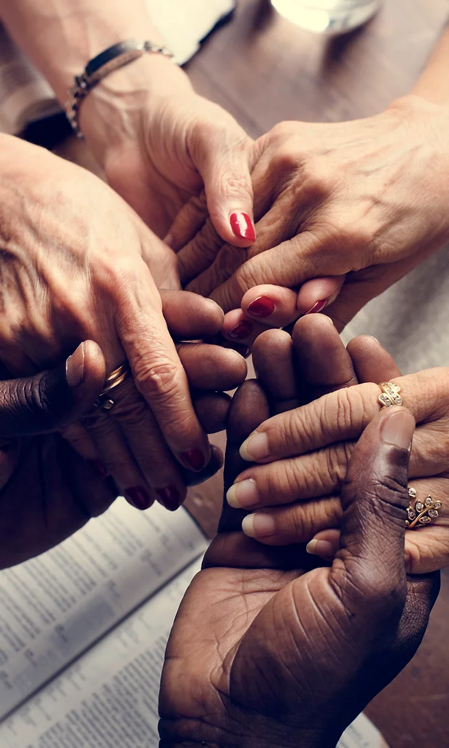
JOYS & CONCERNS
Ann Ragland

Slide 18
Ann Ragland

Slide 19
ANTHEM
“You Are the Seed”
Dennis L. Jernigan
Chancel Choir

Slide 20
1. You are the seed that will grow a new sprout; You’re a star that will shine in the night; You are the yeast and a small grain of salt, a beacon to flow in the dark.

Slide 21
Refrain:
Go, my friends, go to the world, proclaiming love to all,
Messengers of my forgiving peace, eternal love. Be, my friends, a loyal witness, from the dead I arose; “Lo, I’ll be with you forever, till the end of the world.

Slide 22
2. You are the flame tht will lighten the dark, sending sparkles of hope, faith and love; You are the shepherds to lead the whole world through valleys and pastures of peace. You are the friends that I chose for myself, the word that I want to proclaim. You are the new kingdom built on a rock where justice and truth always reign.

Slide 23
Refrain:
Go, my friends, go to the world, proclaiming love to all,
Messengers of my forgiving peace, eternal love. Be, my friends, a loyal witness, from the dead I arose; “Lo, I’ll be with you forever, till the end of the world.

Slide 24
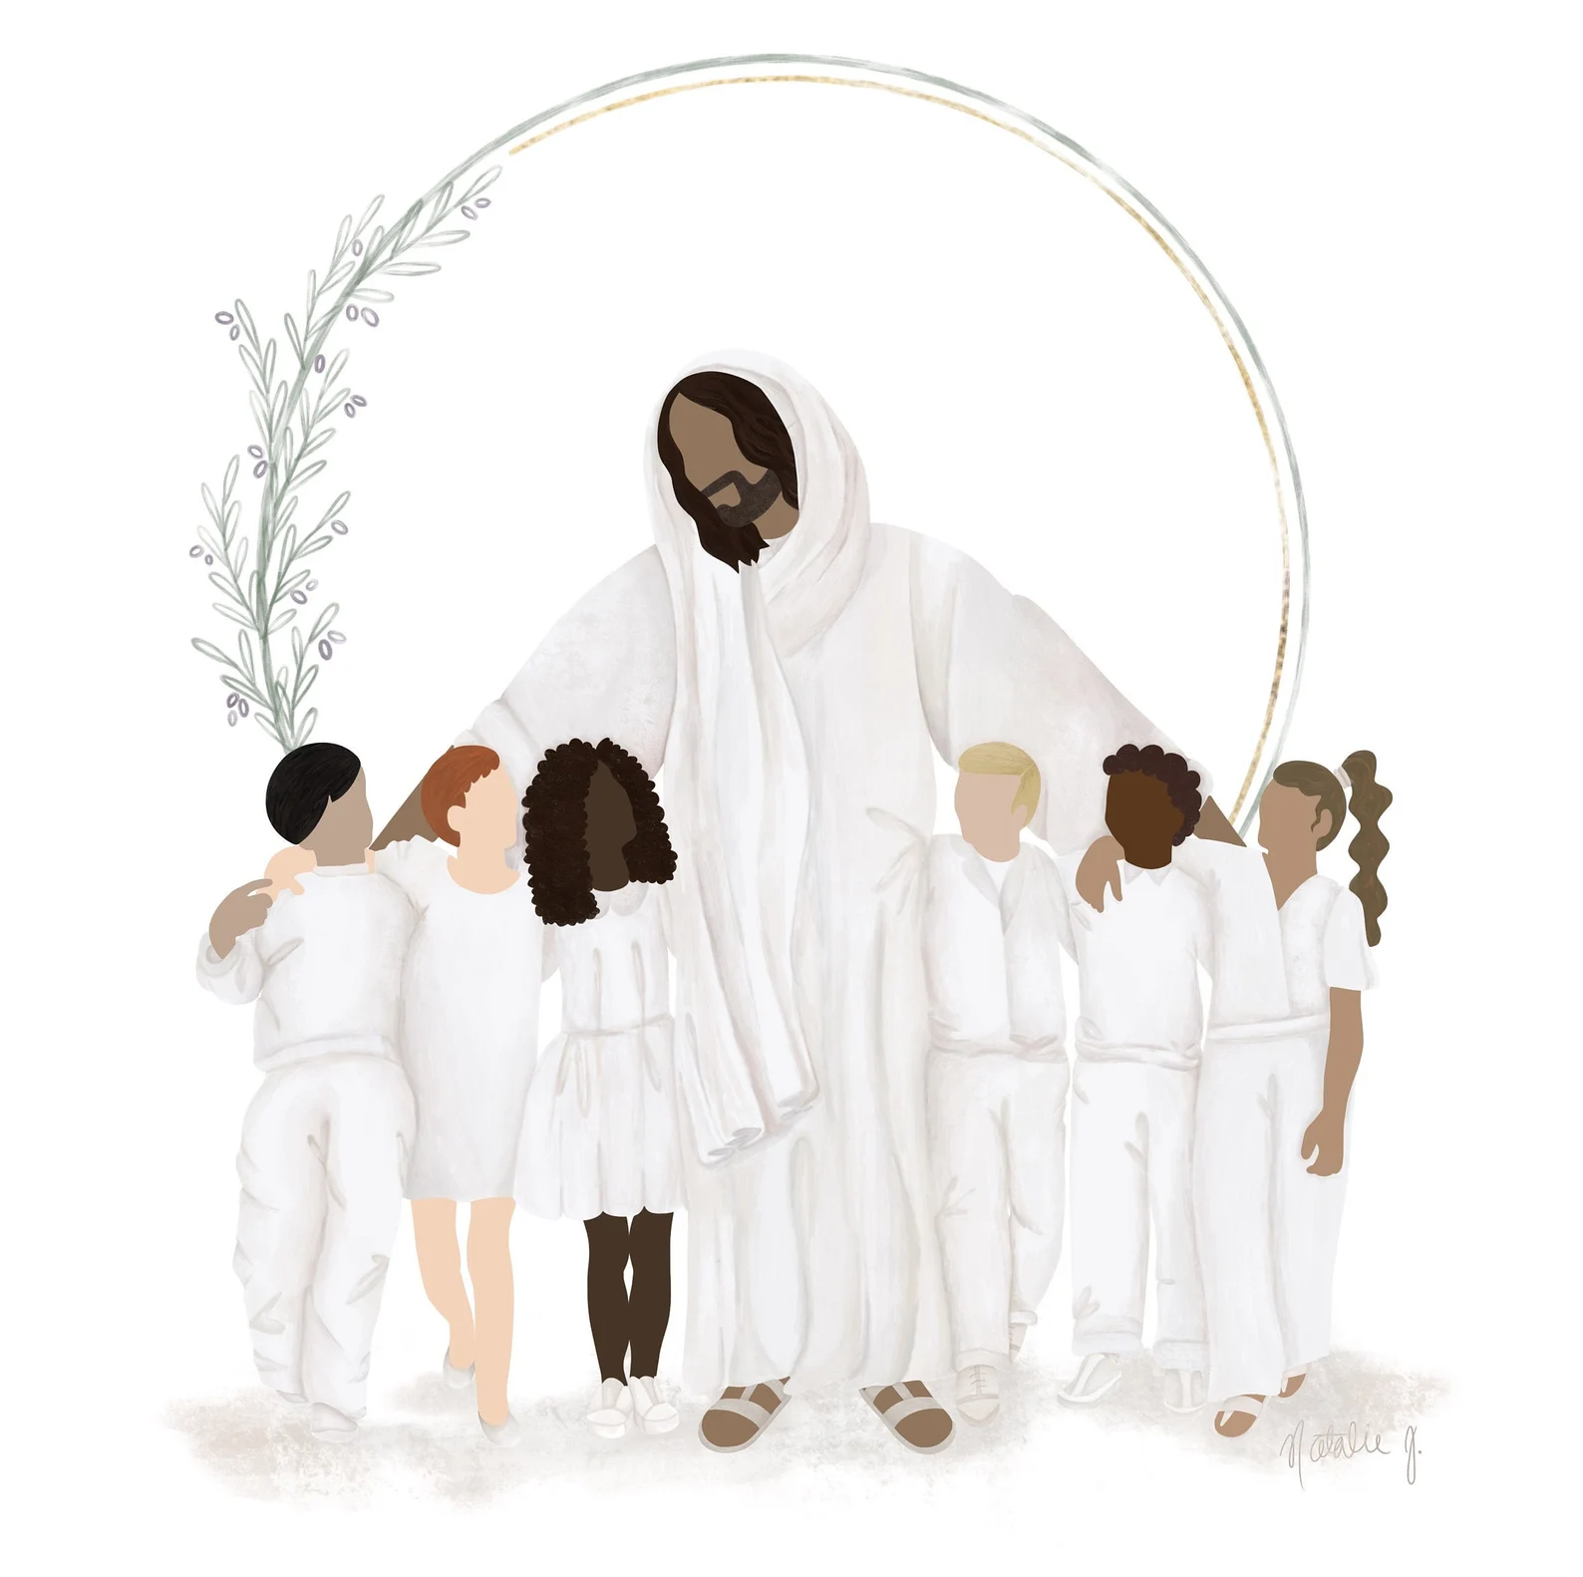
CHILDREN’S MESSAGE
Buddy Whitlow

Slide 25
SCRIPTURE LESSON
^{Matthew 28:16-20}
^{Bud Funk}

Slide 26
Matthew 28:16-20
The Great Commission
Then the eleven disciples went to Galilee, to the mountain where Jesus had told them to go,. When they saw him, they worshiped him; but some doubted. Then Jesus came to them and said, “All authority in heaven and on earth has been given to me.

Slide 28
Then Jesus came to them and said, “All authority in heaven and on earth has been given to me. Therefore go and make disciples of all nations, baptizing them in the name of the Father and of the Son and of the Holy Spirit, and teaching them to obey everything I have commanded you. And surely I am with you always, to the very end of the age.”

Slide 29
SERMON
“The Great Commission”
Bud Funk

Slide 30
HYMN OF RESPONSE
“He Touched Me”
(UMH 367)

Slide 31
1. Shackled by heavy burden, neath a load of guilt and shame, then the hand of Jesus touch me, and now I am no longer the same. (Refrain) He touched me, O he touched me, and O the joy that floods my soul! Something happened, and now I know, hetouched me and made me whole.

Slide 32
2. Since I met this blessed Savior, since he cleansed and made me whole I will never cease to praise him; I’ll shout it while eternity rolls. (Refrain) He touch me, O he touched me, and O the joy that floods my soul! Something happened, and now I know, he touched me and made me whole.

Slide 36
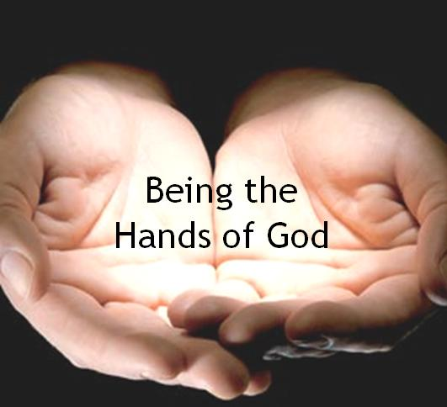
TITHES & OFFERINGS
“My Tribute”(UMH 99)

Slide 37
TITHES & OFFERINGS
To God be the glory, (X3) For the things He has done. With His blood He has saved me, With His power He has raised me, To God be the glory, For the things He has done.
“My Tribute”(UMH 99)

Slide 38
HYMN OF COMMITMENT
“Pass It On” (UMH 572)

Slide 39
1. It only takes a spark to get a fire going, and soon all those around can warm up in its glowing. That’s how it is with God’s love once you’ve experienced it; you spread his love to everyone; you want to pass it on.

Slide 40
2. What a wondrous time is spring, when all the trees are budding; the birds begin to sing, the flowers start their blooming. That’s how it is with God’s love once you’ve experienced it; you want to sing, it’s fresh like spring, you want to pass it on.

Slide 41
3. I wish for you, my friend, this happiness that I’ve found; you can depend on him, it matters not where you’re bound. I’ll shout it from the mountaintop; I want my world to know; the Lord of love has come to me, I want to pass it on.

Slide 44
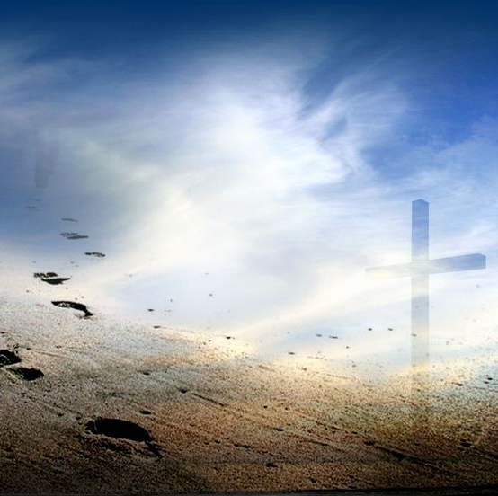
BENEDICTION
Bud Funk

Slide 45
POSTLUDE
“Postlude in C Minor” – John Toutman
Organist: Pam Wilson

